Slide 1
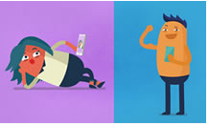


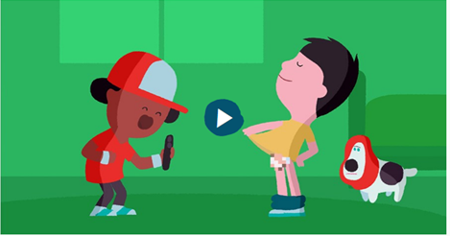
Keeping Safe Online
A guide for parents, carers and families
Rebecca Swift
Equalities Adviser
Education and Skills
North Yorkshire County Council
Notes:
1

Slide 2
Questions
Would you talk to someone you didn’t know?
Would you speak to someone you have never met like they were your best friend?
Would you speak to someone you have never met and be really horrible to them?
Would you hang up your personal pictures of yourself in a public place for everyone to see?
Would you walk around naked/ topless?
Would you tell any one where you lived /Which school you went to?
Notes:
Can do as a continuum line

Slide 3
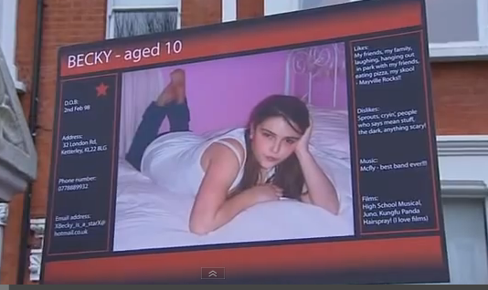
Jigsaw for 8-10 yr olds
https://www.youtube.com/watch?v=_o8auwnJtqE

Slide 4
Four broad approaches that parents can adopt to keep their children safe online:
Education and advice: Parents can teach their children about the risks of harm, why certain types of online behaviour may expose them to harm and how to avoid this (e.g. by discussing social networking privacy settings, or how to handle contact from unknown individuals). Open discussion of the risks to which children may be exposed is particularly important, as it may help encourage children to let their parents know when they have unpleasant or distressing experiences (for example, if they are subject to abusive comments/bullying).
Supervision: Parents can directly supervise their children’s internet use, the sites and services they visit and the interaction and communication in which they participate. Supervision is likely to be most relevant for younger children.
Rules about internet use: These may cover place and time: e.g. “only access the internet in the living room/when there is a parent present”; “only access the internet for x hours a day”. Rules about online interaction and behaviour may help complement education and advice (e.g. “only communicate with friends/people you know”).
Tools and safety mechanisms: Finally, there are technical tools, including filtering software and site safety mechanisms to restrict the internet sites and services to which children have access.

Slide 5
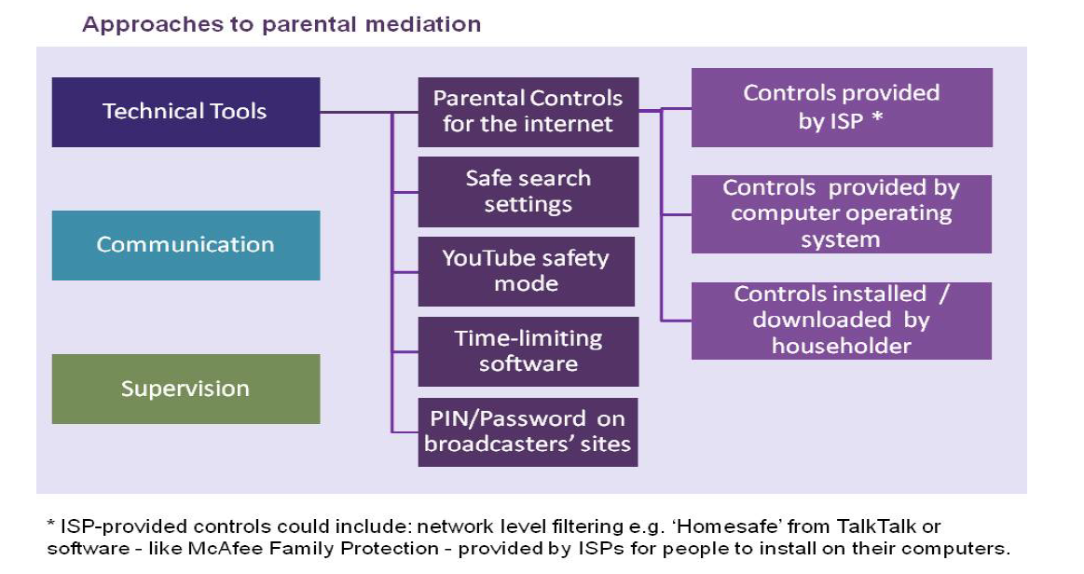

Slide 6
Key Stage 1 (Age 6) data from the Growing Up In North Yorkshire Survey 2016
Question | North Yorkshire average
Pupils responded that they have a computer, tablet or mobile device at home | 97%
Pupils responded that an adult always knows what games they are playing on a device | 55%
Pupils responded that they mostly use a computer at home by themselves | 64%
Pupils responded they use a device to go online/ use the internet | 70%
Pupils responded that an adult always knows what they are looking at online | 46%
Pupils responded that they have friends online that they don’t know in real life | 17%
They have had lessons at school about how to keep safe on line | 54%

Slide 7
Data in North Yorkshire 2016 (2014 data in brackets)
 | Year 2 Pupils | Boys Year 6 | Boys Year 8 | Boys Year 10 | Girls Year 6 | Girls Year 8 | Girls Year 10
Communicate with people online that they don’t know in real life | 17% 19% Boys 14% Girls | 13% (17%) | 17% (18%) | 25% (30%) | 4% (7%) | 11% (12%) | 16% (26%)
Sending messages to one of two people |  | 38% (40%) | 57% (66%) | 73% (80%) | 55% (57%) | 72% (86%) | 85% (92%)
Video chat |  | 35% (43%) | 39% (49%) | 44% (49%) | 49% (56%) | 58% (61%) | 60% (58%)
Online games |  | 51% (56%) | 61% (65%) | 63% (63%) | 10% (14%) | 9% (10%) | 8% (8%)
Picture/video sharing sites/apps |  | 28% (29%) | 41% (42%) | 49% (52%) | 38% (42%) | 60% (63%) | 73% (74%)

Slide 8
2016 Data in North Yorkshire (2014 data in brackets)
 | Boys Year 6 | Boys Year 8 | Boys Year 10 | Girls Year 6 | Girls Year 8 | Girls Year 10
Seen pictures, videos or games they found upsetting | 5% (14%) | 5% (9%) | 8% (10%) | 6% (16%) | 9% (15%) | 17% (22%)
Someone writing or showing things to hurt or upset you (text, pictures, videos) | 8% (12%) | 8% (11%) | 11% (14%) | 10% (15%) | 19% (25%) | 24% (30%)
Sent something then wished they hadn’t or thought more about it | 2% (9%) | 3% (5%) | 6% (8%) | 2% (14%) | 6% (10%) | 11% (20%)
Seen sexually explicit images, videos or games | N/A | 11% (18%) | 26% (33%) | N/A | 10% (13%) | 20% (30%)
Received sexting images | NA | 12% | 24% | NA | 15% | 33%

Slide 9
What percentage of pupils say they have been told how to keep safe online? (2016)
Year Group | Boys found lessons about keeping safe online as useful | Girls found lessons about keeping safe online as useful
Year 2 | 56% | 55%
Year 6 | 72% | 78%
Year 8 | 65% | 74%
Year 10 | 52% | 62%

Slide 10
What percentage of parents have internet parental controls set?
43% of parents of online 5-15s and 40% of parents of 3-4s report having parental controls a in place on a PC, laptop or netbook.
Four in ten parents of online 5-15s say they use safe search settings on search engine websites.
YouTube Safety Mode: Two in ten parents have the Safety Mode set.
One in three online children now watch television content via UK television broadcasters’ websites. Around one in four of the parents who are aware of the guidance labels have set up a PIN or password to be used before viewing programmes that have a guidance label
Over half of parents do not use parental controls i.e. those provided by their ISP, their computer’s operating system or programmes installed or downloaded by someone in their household.
26% on games consoles
15% on phones
Ofcom Children and parents: media use and attitudes report
Oct 2014
Notes:
What do we mean by parental controls?

Slide 11
Reasons why parents don’t use parental controls:
Trust child to be sensible/ responsible
Child is always supervised
Child too young for this to be a problem (more for 5-7 year olds)
Child too young to surf/ look around the web (more for 5-7 year olds)
Unaware how to
Parents who do not have filters installed on their mobile phones say the main reason is that they trust their child to be responsible (55%). However, a significant minority respond that they are not aware that this is possible (31%) or don’t know how to do it (7%)
Those parents who do not have parental controls set on games One third of parents say this is because they trust their child to be sensible/responsible, around three in ten say it is because their child is always supervised and around one in ten say it is because the child is too young for this to be a problem

Slide 12
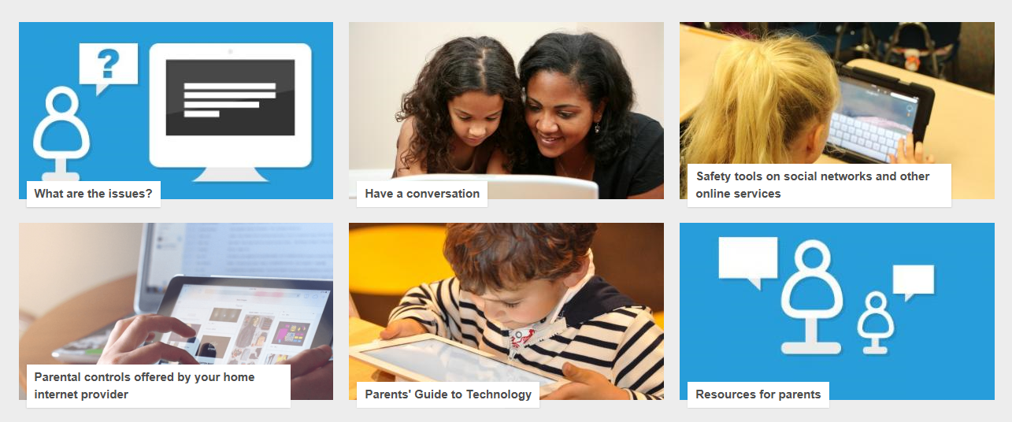
www.saferinternet.org.uk – parent controls

Slide 13





A Safer Set Up
Internet Filtering
Safe Search modes for search engines
Family Safety Centre
Preferences
Parental Controls
Safety Mode

Slide 14



Safety Rules – do they change?
Notes:
Don’t have to be an expert on

Slide 15
Online Safety
The breadth of issues classified within e-safety is considerable, but can be categorised into three areas of risk:
CONTENT: being exposed to illegal, inappropriate or harmful material
CONTACT: being subjected to harmful online interaction with other users
CONDUCT: personal online behaviour that increases the likelihood of, or causes, harm.

Slide 16
Things that could go wrong
Content | Contact | Conduct
Exposure to inappropriate content, including online pornography, ignoring age ratings on games and substance abuse | Grooming | Privacy issues, including disclosure of personal interest
Lifestyle websites (e.g pro anorexia) | Cyber bullying | Digital footprint / tatoo and online reputation
Hate sites | Identify theft and sharing passwords | Health and wellbeing (how much time spent online (internet /gaming)
Content validation: how to check authenticity and accuracy of online content | Radicalisation | Sexting
 |  | Copyright – little care or consideration for intellectual property and ownership – such as music and film

Slide 17



Facebook
Instragram
Snapchat
Social Networking
Everything is about interaction – people share, exchange, create etc
Young people need to take on the responsibility of being safe online users
Need to teach them about safe online behaviour so they can eliminate and reduce the risk to themselves and others
Young people don’t want the technology taken away so they do tolerate certain behaviours

Slide 18
Social Media
Webcam – school uniform and other clues in the background
Webcam left on or turned on remotely
Pictures of children on parents or siblings social network - tagging
Privacy settings left open or incorrect
Profiles e.g. on MSN – don’t have to give all the information
A ‘friend’ passes on private info or pics
Do you know who you’re talking to?

Slide 19
Location-based services
Location-based services (LBS) make use of the inbuilt facilities of mobile phones to provide content and services based on geographical location. Recently launched services such as Facebook Places, Foursquare and Google Latitude allow people to broadcast their locations to friends, often with a gaming element to encourage people to ‘check in' or upload location-tagged photos. Concerns therefore relate to privacy and contact, especially with the ability to pinpoint the exact location of a participating young person at any given time.

Slide 20
Cyber-bullying
24/7 - invasion of home/personal space
Audience can be large & reached rapidly
May attempt to be anonymous
Often between children – also across generations; teachers have been targets
Bystanders can become accessories
Cyberbullying incidents can act as evidence

Slide 21
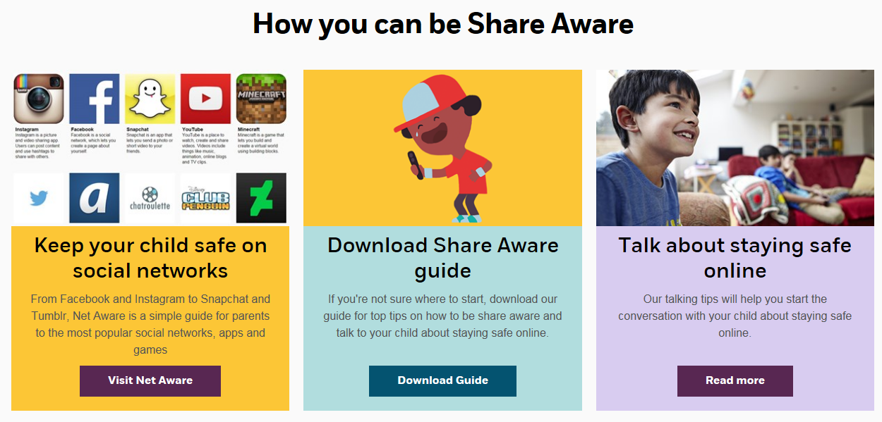
Share Aware http://www.nspcc.org.uk/shareaware

Slide 22
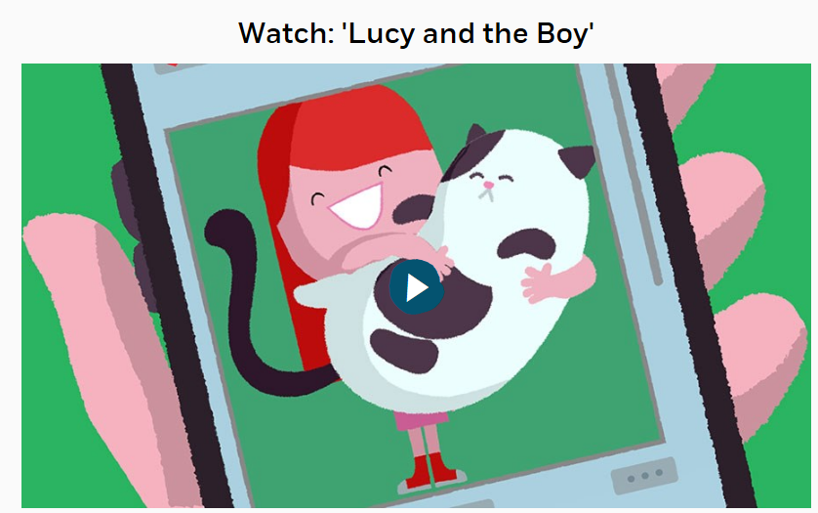
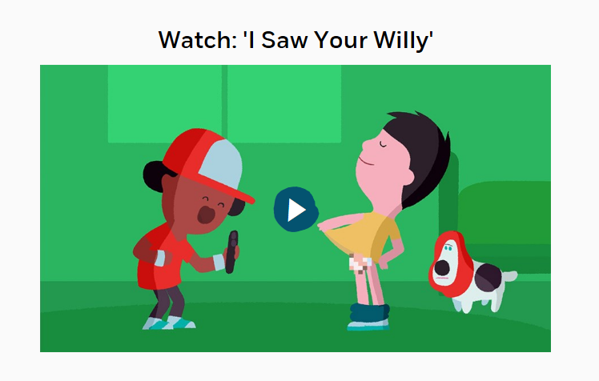
Sharing Inappropriate Images / Keeping Safe
http://www.nspcc.org.uk/shareaware
https://www.nspcc.org.uk/preventing-abuse/keeping-children-safe/share-aware/

Slide 23
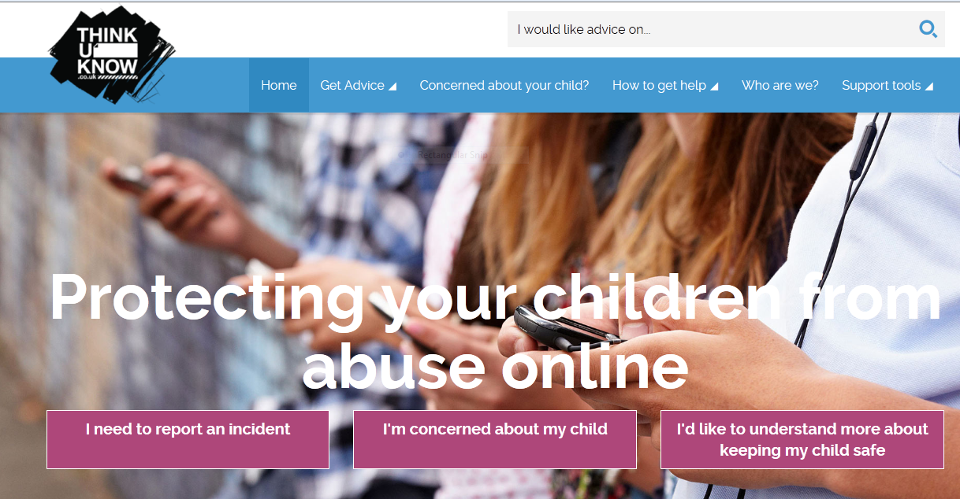
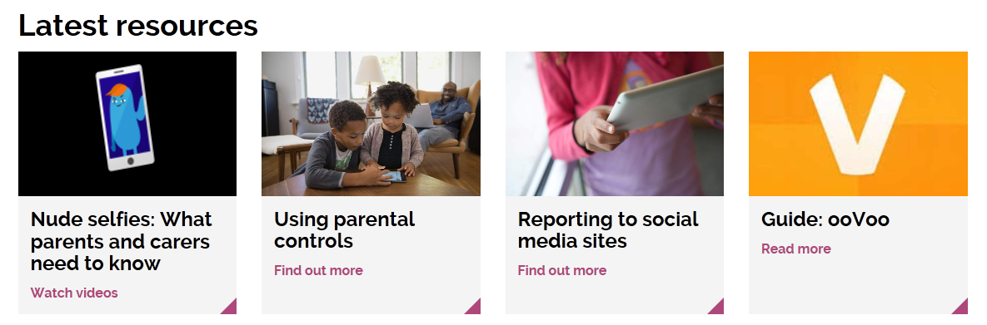
https://www.thinkuknow.co.uk/parents/

Slide 24
Grooming
Basically, grooming is manipulation.
Sometimes it involves flattery, sometimes sympathy, other times offers of gifts and money.
Experts say the short-term goal of these manipulators is for the victim to feel loved or just comfortable enough to want to meet them in person, or do things via webcam and these people know that sometimes takes time.
Groomers tend to have a lot of patience, and they also tend to “work” a number of targets at once, telling all of them that they are “the only one for me.”

Slide 25
“Let’s go private.” (leave the public chatroom and create a private chat or move to instant-messaging or phone texting)
“Where’s your computer in the house?” (to see if parents might be around)
“Who’s your favourite band? designer? film? gear?” (questions like these tell the groomer more about you so they know what gifts to offer – e.g., concert tickets; Webcam, software, clothes, CDs)
“You seem sad. Tell me what’s bothering you.” (the sympathy approach )
“What’s your phone number?” (asking for personal info of any kind – usually happens at a later stage, after the target’s feeling comfortable with the groomer – but all online kids know not to give out personal info online, right?!)
“If you don’t… [do what I ask], I’ll… [tell your parents OR share your photos in a photo blog / Webcam directory / file-sharing network]“ (intimidation – used as the groomer learns more and more about the target)
“You are the love of my life.”
Notes:
Being aware of these tactics – and the fact that groomers are self-taught experts in 1) getting kids to reveal their needs and desires and 2) tailoring messages to those interests – can go a long way toward protecting kids from sexual exploitation online. It’s also a great exercise in critical thinking, the best safeguard and “filter” a young Net user can have. A great resource on grooming specifically written for teens is “Cyber stalking, abusive cyber sex and online grooming: A Program of Education for Teenagers” (starting on p. 23). The program was written by Rachell O’Connell, Joanna Price, and Charlotte Barrow of the Cyberspace Research Unit of the University of Central Lancashire in the UK.

Slide 26


Key Features of online games
Multiplayer online games
Players use cartoon avatars (penguins, moshi monster) and play in a virtual world.
Free memberships are available, revenue is predominantly raised through paid memberships which allow players to access a range of additional features
They all promote ‘communicate with other users in a safe environment’ (penguin – choose set responses from a drop down menu, have ‘moderators’ who patrol the game)
Notes:
Breck Bednar, a 14-year-old boy who loved gaming, was groomed online and murdered in 2014

Slide 27

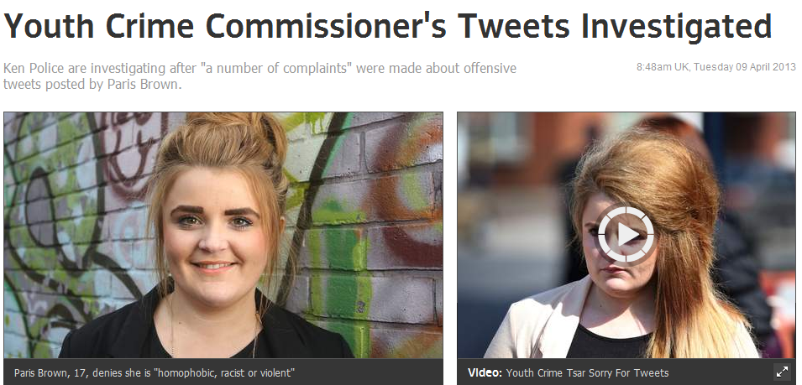
Digital Footprint / tattoo
Facebook:
63% of mums use Facebook; of these, 97% said they post pictures of their child; 89% post status updates about them, and 46% post videos
Information is being provided, which might include things like date of birth, place of birth, the child’s full name, or tagging of any photographs with a geographical location – anything that could be used by somebody who wanted to steal your child’s identity.
The second issue is more around consent. What type of information would children want to see about themselves online at a later date?”

Slide 28

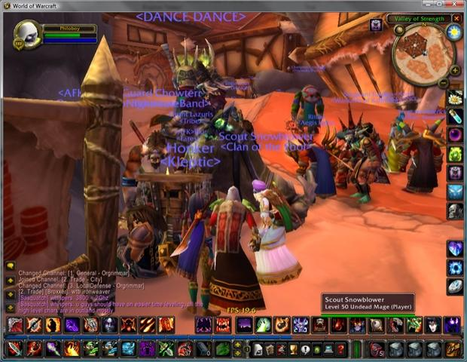
Take an interest in what your child does online
social media
online gaming
phone or iPod

Slide 29
Top Tips
TOP TIPS
Talk to your child about what they’re up to online.
Model ‘good’ behaviour online and when using technology
Watch Thinkuknow/ shareaware films and cartoons with your child on the topic.
Keep up-to-date with your child’s development online.
Set boundaries in the online world just as you would in the real world.
Ensure they have non-screen time – children should have 60 mins of physical activity a day and a minimum of 10 hours sleep
Consider when, where and how your children can connect – are they safe? It is 24 hours/ 7days a week – primary aged children need about 10 hours of sleep a night
Use parental controls on devices that link to the internet, such as the TV, laptops, computers, games consoles and mobile phones.

